Slide 1
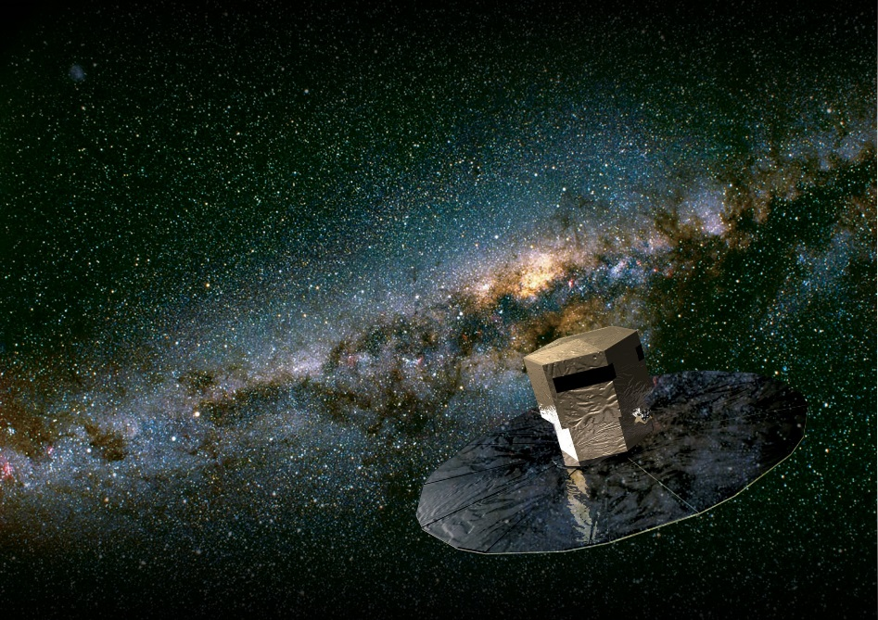
Gaia DR1: a few warnings and caveats
e.g. the importance of using variance/covariance quantities
U. Bastian, Gaia User Workshop, ARI 4.4.2016

Slide 2
Introduction to Gaia
Skipped – Stefan gave it less than an hour ago !

Slide 3
Forthcoming first Gaia data release
„Gaia DR1“ 14.6/11.8 months
end of summer 2016
1 billion positions and G magnitudes (old plan, still true)
plus 2 million parallaxes and proper motions (very new)

Slide 4
The 1 billion positions
Probably ~1.5 billion
Mostly G=12-20
On average on the ICRS/ICRF system to sub-mas precision.
But:
too few Gaia observations for 5-parameter solutions
Bayesian prior that parallax and motions are „small“, implying a Galaxy model, see Michalik et al 2015, A&A, 583, A68, ArXiV 1507.02963
effectively a „reasonable“ 2-parameter solution; no pm and parallaxes published
Thus:
typically uncertain by 1-3 mas due to unknown parallax and proper motion
perhaps 10 percent with formal uncertainties >15 mas
a few unrecognized high proper motions and parallaxes -> outliers and of course the usual outliers due to disturbed measurements
No problem for all applications that I could think of.
giant advance over all existing large reference catalogues
precision and accuracy quickly deteriorating (few years, both future and past)
for the future: to be replaced by Gaia DR2 before this problem can take effect in the future
for the past: the time of applicability can be extended by combination with known pm, or by direct combination with older known positions

Slide 5
The 2 million parallaxes and motions
Too few Gaia observations for 5-parameter solutions
Solved by combination with Tycho-2 positions
genuine 5-parameter solutions
valid proper motions and parallaxes
but: depending on Tycho-2 (incl. HIP) positions, not on Tycho-2 and HIP motions and parallaxes, however.
Comparisons:
Number of objects: 20 times better than HIP
Parallaxes typically below 0.5 mas, i.e. better than HIP
Motions typically 2 mas/yr, i.e. worse than HIP (but 0.1 mas for HIP stars)
Systematic errors: worse than HIP; a number will be given with the release
Not yet comparable with expected Gaia performances ! DR2 will be the first proper Gaia Catalogue
Beware of the systematics !

Slide 6
Systematic errors
Size in DR1 is similar to the individual uncertainties
causes:
colour terms, PSF time variations, basic-angle oscillations
clanks
dependence on Tycho-2
...
Averages over many stars will not be (much) better than the numbers for a single star
Clusters, absolute brightness of standard candles, ...
Recipe: - quadratically add a systematic uncertainty after averaging better: - give separate random and systematic uncertainties

Slide 7
Example
N=400 stars, each with sigma(parallax) = 0.5 mas
sqrt(N) law gives sigma(average) = 0.025 mas = 25 muas completely unrealistic for DR1 !

Slide 8
The inverse of a parallax ...
... is not necessarily a distance
Insignificant parallaxes
Negative parallaxes
Marginally significant parallaxes
Look at the standard errors in the catlg file(s)
And then of course: Outliers
Small degree of freedom per star (hampering outlier rejection)

Slide 9
The inverse of a parallax ...
Mean, median, mode, rms of a trigonometric distance
Consider a given true parallax p
Distance D=1/p (see next page)
Recipe to avoid scientific trouble:
Always use forward modelling to measured parallaxes to fit higher-level unknown quantities
In other words: Do not use derived quantities like individual distances or absolute magnitudes to fit higher-level unknown quantities

Slide 10
The inverse of a parallax ...

Slide 11
The inverse of a parallax ...
„Estimating distance from parallax“, C. Bailer-Jones, EWASS 2016 & PASP, Oct 2015
Various Bayesian priors giving realistic means and variances - for various circumstances

Slide 12
Gaia image of the week, 2015-12-19

Slide 13
Now for something funny but serious: M11
Variances/mean errors
Covariances/Correlations
Condition number (inverse)
GoF (F2)
Source excess noise
Solution_1512170101, members position-selected
Wow ! An exploding cluster ??
Data from a preliminary solution; but actual Gaia DR1 will look quite similar

Slide 14
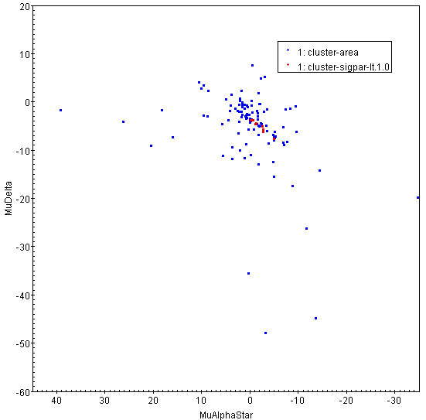
Now for something funny but serious: M11
Variances/mean errors
Covariances/Correlations
Condition number (inverse)
GoF (F2)
Source excess noise
Wow !
Data from a preliminary solution; but actual Gaia DR1 will look quite similar

Slide 15
During this presentation
- about 1 million stars were measured by Gaia, - roughly 10 million astrometric measurements were taken, - about 300,000 spectra were made of 100,000 stars

